Slide 1
CS 329E Final Project
Benjamin Liu
Wilson Lu
Notes:
Will run mini-lisp.py

Slide 2
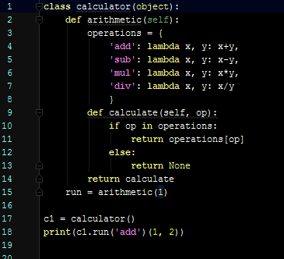
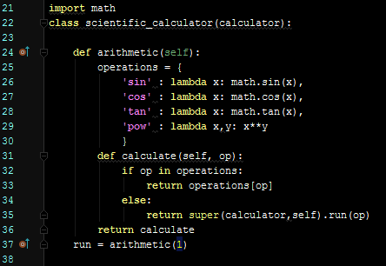
Python Closures
(exec 'from Calculator import calculator; toReturn = calculator().run("add")(1, 2)')
(exec 'from Calculator import scientific_calculator; toReturn = scientific_calculator().run("cos")(3.1416)')
(exec 'from Calculator import scientific_calculator; toReturn = scientific_calculator().run("div")(144.0, 11.0)')
Notes:
Removed Parsing functions (parse, tokenize, and read_from_tokens) in the beginning of lis.py and Interaction functions (repl, lispstr) in the middle of lis.py
Removed Built-in and evalution functions in the beginning of yacc.py

Slide 3
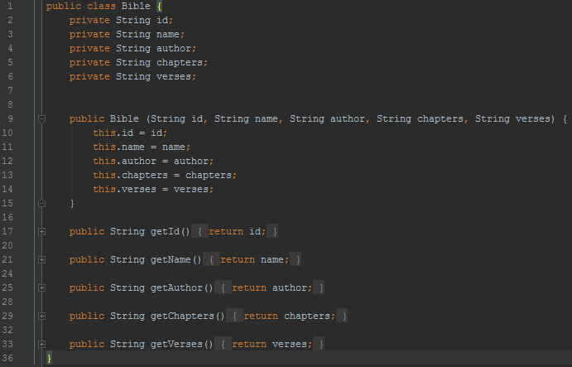
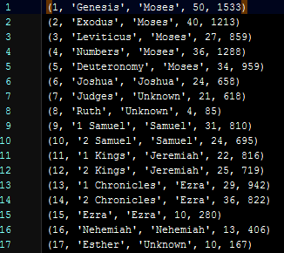
Java Stream Operations
Class: Bible.java bible.txt

Slide 4
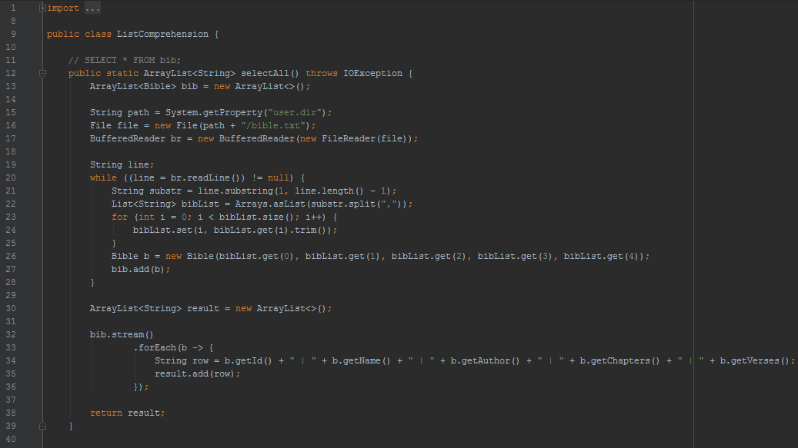
Java Stream Operations: ListComprehension
(exec 'import ListComprehension; toReturn = ListComprehension.selectAll()')

Slide 5
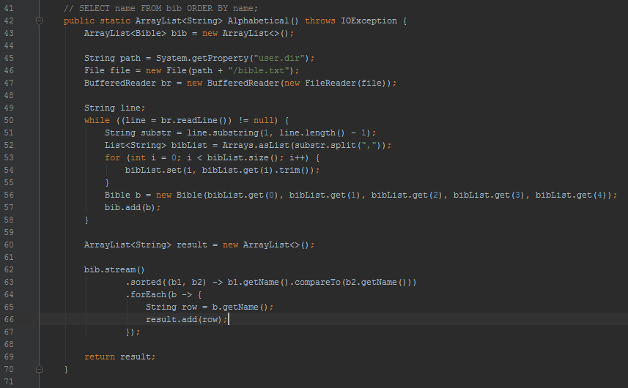
Java Stream Operations: ListComprehension
(exec 'import ListComprehension; toReturn = ListComprehension.Alphabetical()')

Slide 6
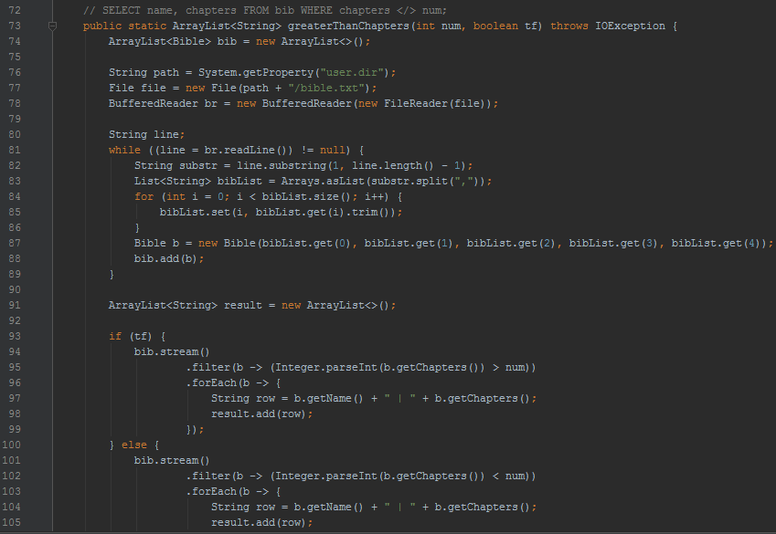
Java Stream Operations: ListComprehension
(exec 'import ListComprehension; toReturn = ListComprehension.greaterThanChapters(25, 1)')

Slide 7
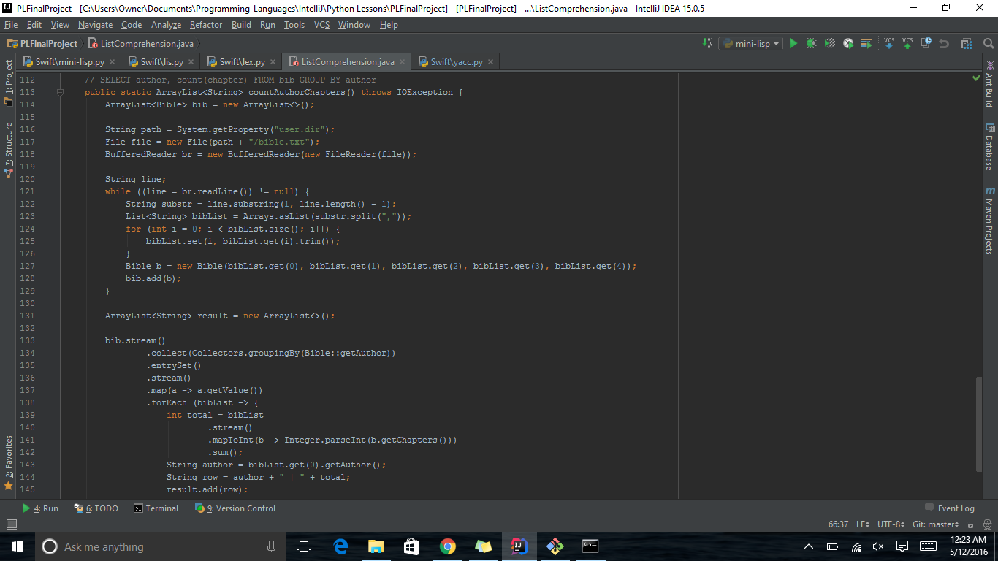
Java Stream Operations: ListComprehension
(exec 'import ListComprehension; toReturn = ListComprehension.countAuthorChapters()')

Slide 8
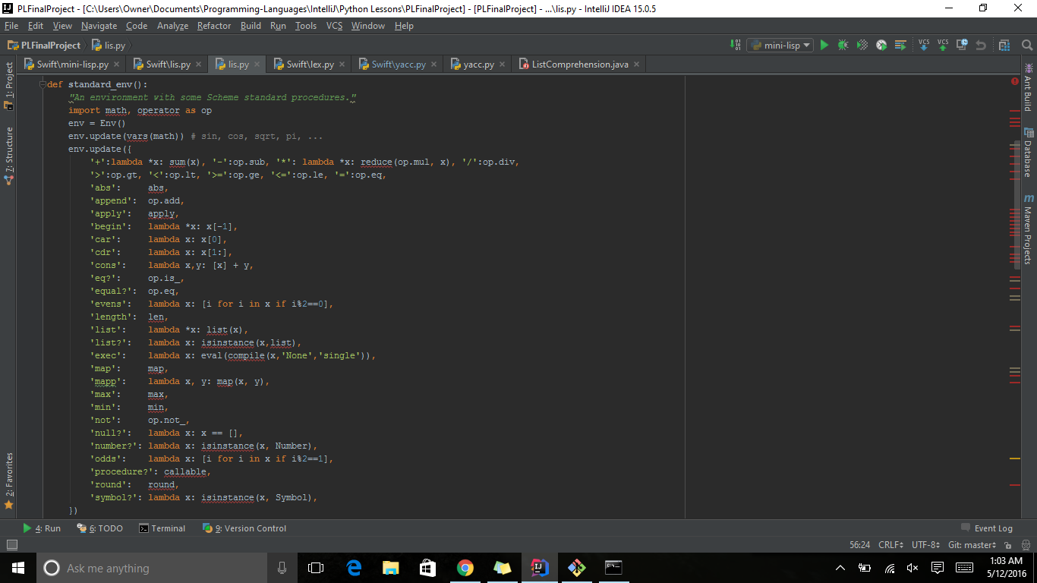
Python Lambda
(evens '(1 2 3 4 5 6 7))
(odds '(1 2 3 4 5 6 7))
(mapp (lambda x (+ x 1)) '(5 10 15))

Slide 9
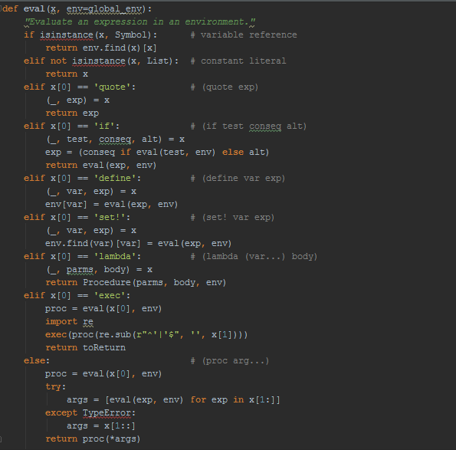
Bugs & Improvements
(+ 1 2 3 4 5 6 7 8 9 10)
(* 2 3 5 7 11)
(evens (1 1 2 3 5 8 13))
(car (4 6 8 9 10))

Slide 10
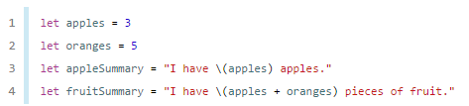
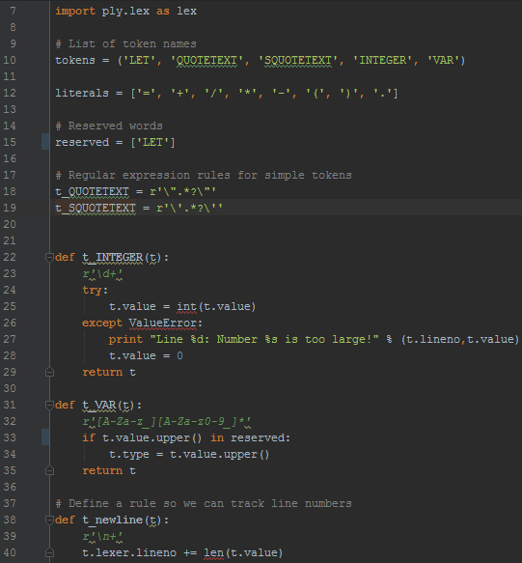
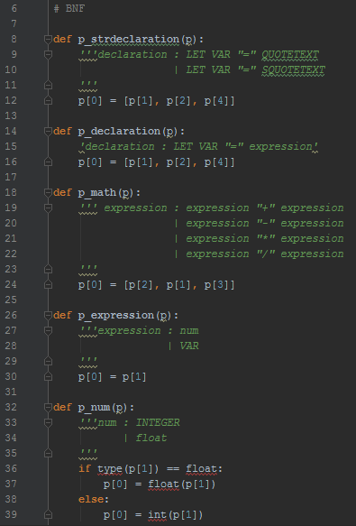
Swift
Goal: Lexer: Parser:
Major Difficulty:
Calculating the \() inside the string

Slide 11
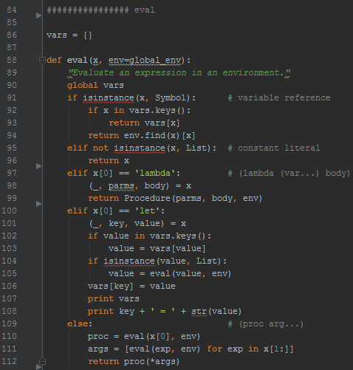
Swift
let a = 1
let b = 3.14
let c = 5 * 1.2
let d = b - c
let e = "Hello World"

